Slide 1

DISASTER
MANAGEMENT
By
PANKAJ CHAUDHARY,
INSPECTOR
05 BN, NDRF
PUNE

Slide 2
DEFINITION OF DISASTER AS PER DM ACT, 2005
“A catastrophe, mishap, calamity or grave occurrence in any area, arising from natural or man made causes, or by accident or negligence which results in substantial loss of life or human suffering or damage to, and destruction of property, or damage to, or degradation of environment and is of such a nature or magnitude as to be beyond the coping capacity of the community of the affected area.”

Slide 3
DISASTER MANAGEMENT
As per clause 2 (e) of the Disaster Management Act, 2005 defines disaster management as a continuous and integrated process of planning, organizing, coordinating and implementing measures which are necessary or expedient for –
Prevention of danger or threat of any disaster.
Mitigation or reduction of risk of any disaster or its severity or consequences.
Capacity-building.
Preparedness to deal with any disaster.
Prompt response to any threatening disaster situation or disaster.
Assessing the severity or magnitude of effects of any disaster.
Evacuation, rescue and relief.
Rehabilitation and reconstruction.

Slide 4
Vulnerability Profile of India
  58.6% of the landmass is prone to earthquakes of moderate to very high intensity.
  Over 40 million hectares (12% of land) is prone to floods and river erosion.
  Of the 7,516 Kms long coastline, close to 5,700 Kms is prone to cyclones and tsunamis.
  Western & Eastern Himalayan States and Western Ghat States are at risk from landslides and avalanches.
  Further, the vulnerability to Chemical, Biological, Radiological and Nuclear (CBRN) emergencies has also increased.

Slide 5
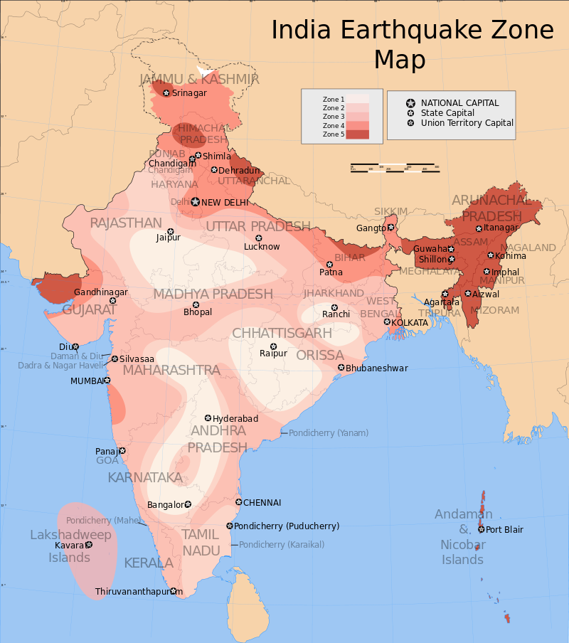

Slide 6
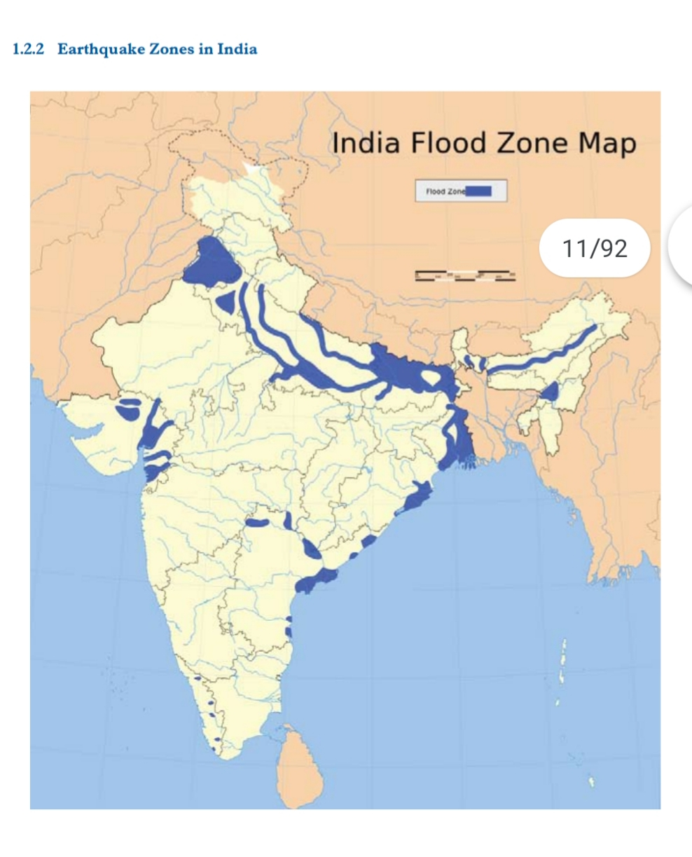

Slide 7
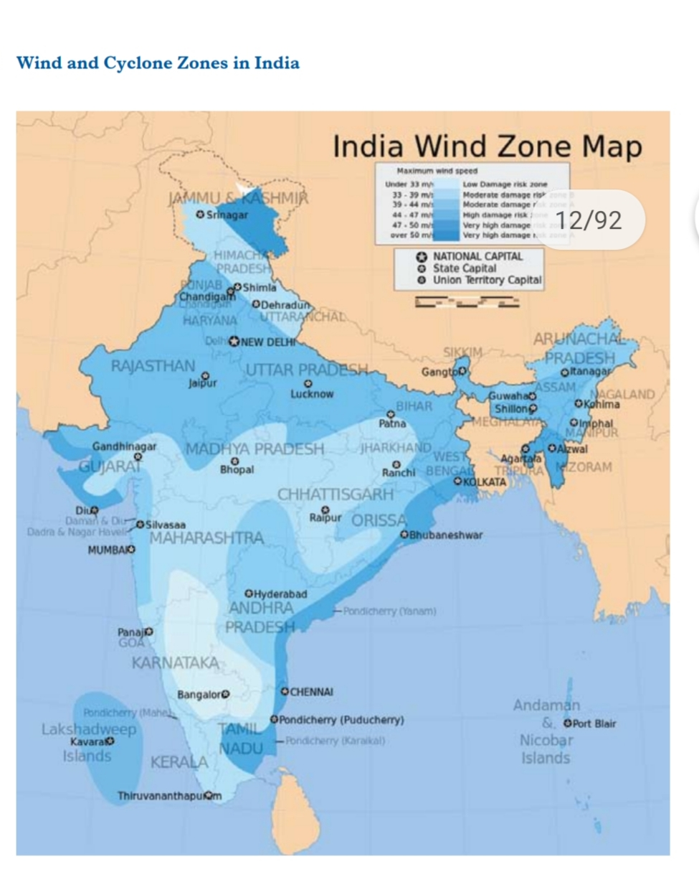

Slide 8
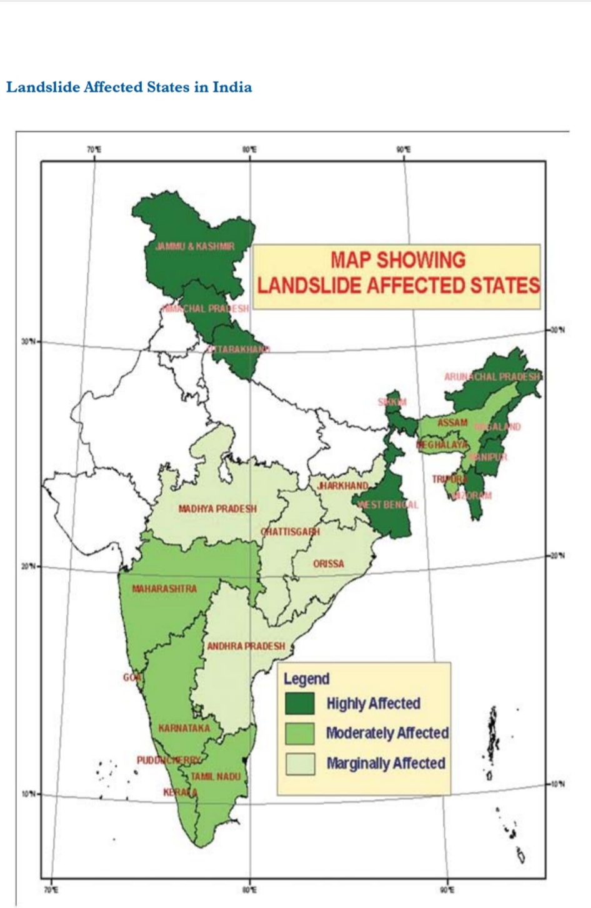

Slide 9
Now Classify Disasters

Slide 10
Classification Of Disaster
Natural or Man-Made
Slow onset or Rapid onset

Slide 11
Name Some Disasters

Slide 12

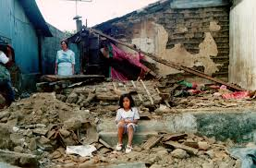
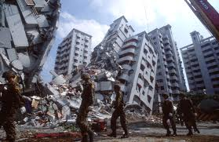
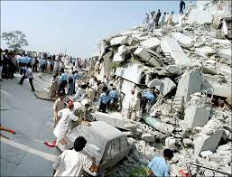
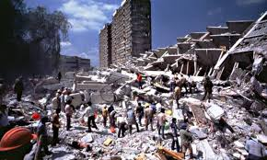
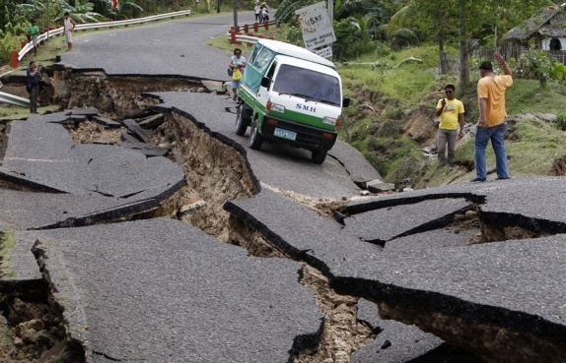
Earthquake

Slide 13
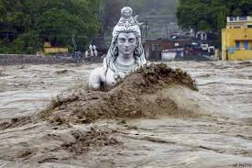
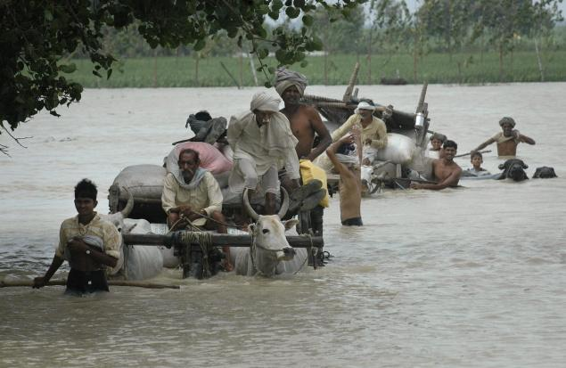
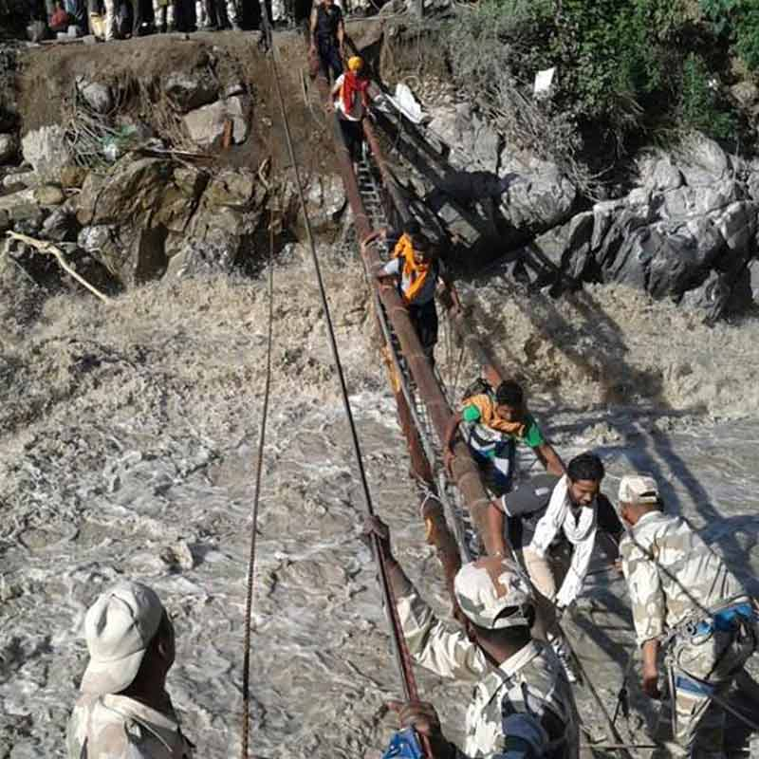
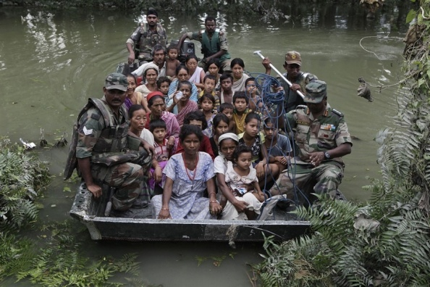
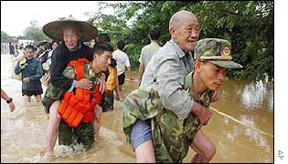
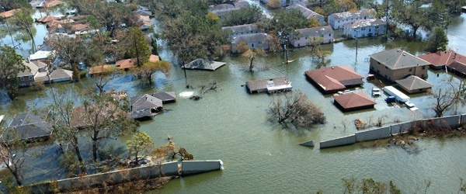
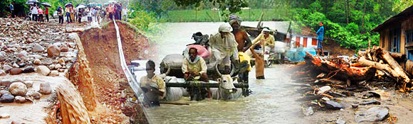
Flood/Flash Flood

Slide 14
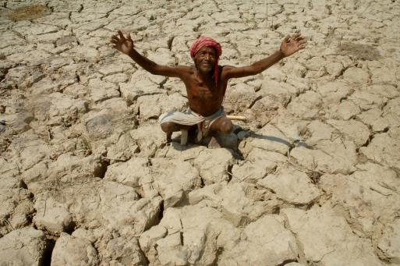
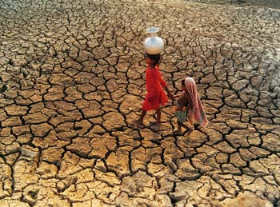
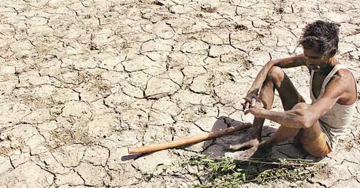
Drought

Slide 15
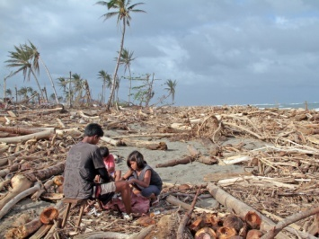
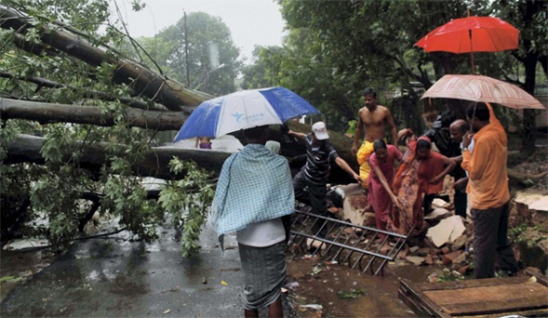
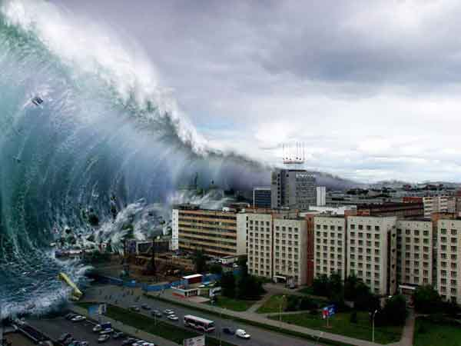
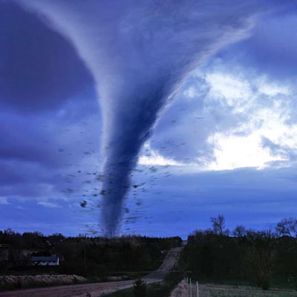

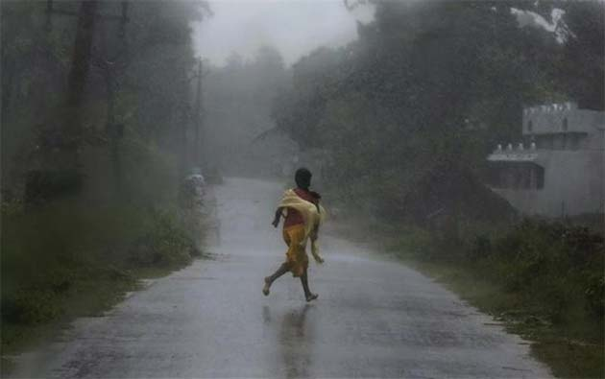
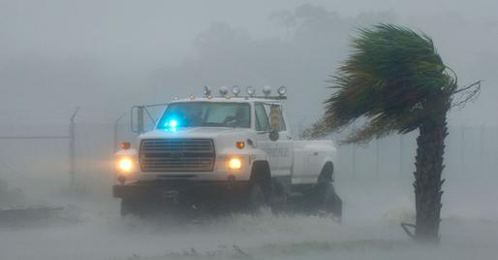
Cyclone/Tsunami

Slide 16
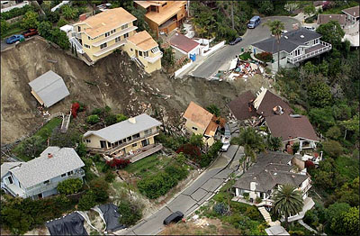
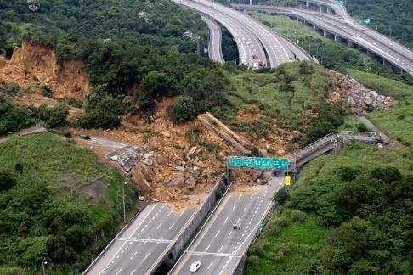
Landslide

Slide 17
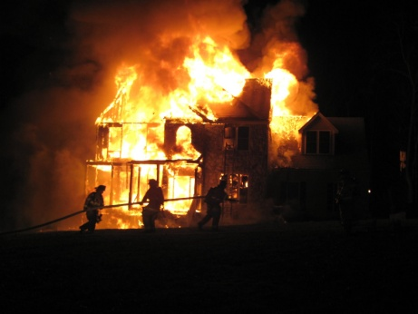
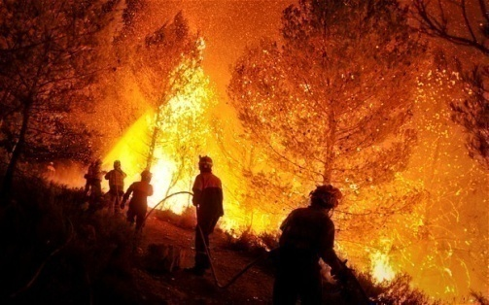
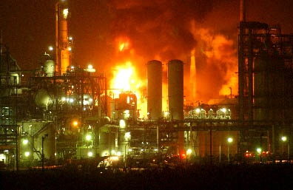
Fire

Slide 18
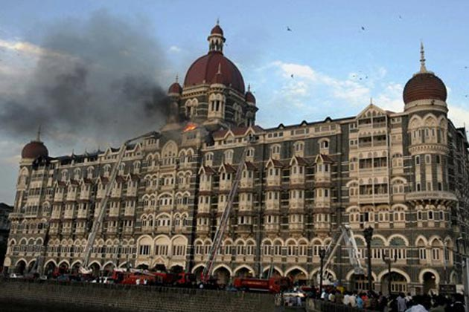
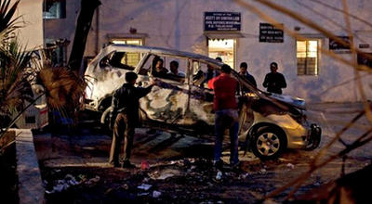

Terror Strike/Bomb Blasts

Slide 19
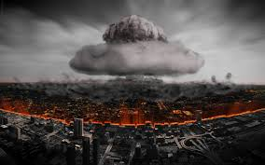
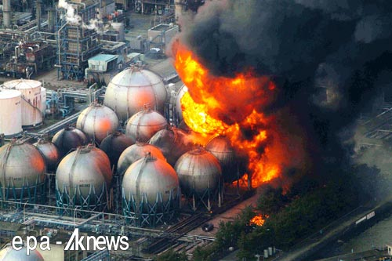
Nuclear Explosions

Slide 20
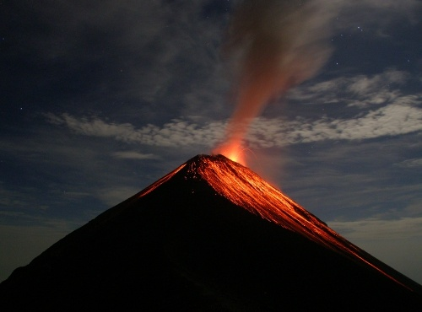
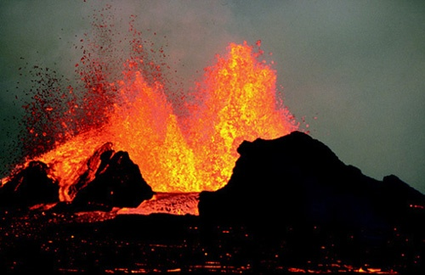
Volcanic Eruptions

Slide 21
MAJOR DISASTERS SINCE 1984
BHOPAL CHEMICAL ACCIDENT, 1984 ( Loss of life 3,800 )
LATUR EARTHQUAKE, 1993 (Loss of life 22,000)
ORISSA SUPER CYCLONE, 1999 (Loss of life 7600)
GUJRAT EARTHQUAKE, 2001 (Loss of life 20,000)
TSUNAMI, 2004 (Loss of life 10,700)
EARTHQUAKE /FLOOD 2005 (Loss of life 140 (J&K)
                8600( POK

Slide 22
MAJOR DISASTERS SINCE 1984
MAHARASTRA FLOODS, 2005 ( Loss of life 1,094 )
KOSI FLOODS BIHAR, 2008 (Loss of life 527)
FLOODS IN SOUTH INDIA 2009 (Loss of life 300)
FLOODS IN UTTRAKHAND 2013 (Loss of life 10,000 APPROX.)
FLOODS IN J&K 2014 (Loss of life 854 )
EARTHQUAKE, NEPAL (Loss of life 12,000)

Slide 23
LATEST MAJOR DISASTERS
Disaster in 2019 -- Cyclone Fani
-- Bihar Flood
Disaster in 2020 – Cyclone Nisarga, Nivar,Burevi
-- Kerala floods
-- Locust attack
Disaster in 2021 -- Cyclone Tauktae, Yass
-- Uttarakhand Flood
-- Maharashtra Flood

Slide 24
Effects of Disasters on our Life

Slide 25

Effects of Disasters
There are three types of effects:-
Primary Effects
Secondary Effects
Long- term Effects

Slide 26
Primary Effects:-
(a) Physical damage to building, bridges, road/ railway, canals & other structure.
(b) Casualties:- People, live stock, environment etc.
Secondary Effects:-
(a) Water Supply, Electric Supply, Communication
(b) Diseases
(c) Crops & food supplies.
Long Term Effects:- (a) Economic hardship (b) Rebuilding Cost, food shortage
(c) Mental Trauma/Psycho-Socio problems.

Slide 27
Factors Responsible for Disasters

Slide 28
Factors Responsible For Disaster
Weather/Environment/Nature
People
Equipment & Material

Slide 29
DISASTER MANAGEMENT
IN
INDIA

Slide 30
MANAGEMENT OF DISASTERS
Until 2001 – Responsibility with Agriculture Ministry.
Committees Set Up by Govt on Disaster Management :-
  High Powered Committee – August 1999 (Just Prior to Orissa Super Cyclone).
  All Party National Committee – Feb 2001 (After Gujarat Earthquake).
  Recommendations.
    High Powered Committee – Setting up of a DM Ministry.
    Ministry of Home Affairs – Setting up of National Emergency Management Authority as a Department of MHA.
Responsibility Transferred to MHA in June 2002 as an Interim Arrangement.
DM Act passed in December 2005.

Slide 31
NEW LAW ENACTED
Disaster Management Act passed on 23th Dec 2005, exactly a year after the Tsunami
Main Vision of the Act is to generate prompt and efficient response mechanism

Slide 32
THE DISASTER MANAGEMENT ACT, 2005,
(23 December 2005)
was passed by the Rajya Sabha, the upper house of the Parliament of India on 28 November,
and by the Lok Sabha, the lower house of the Parliament on 12 December 2005
The Disaster Management Act, 2005 has 11 chapters and 79 sections .
The Act extends to the whole of India. The Act provides for "the effective management of disasters and for matters connected there with or incidental.

Slide 33
CHAPTERS | SECTION | PARTICULARS
CHAPTER I | 01-02 | PRELIMINARY
CHAPTER II | 03-13 | NDMA
CHAPTER III | 14-24 | SDMA
CHAPTER IV | 25-34 | DDMA
CHAPTER V | 35-40 | MEASURES BY THE GOVERNMENT FOR DISASTER MANGEMENT
CHAPTER VI | 41 | LOCAL AUTHORITIES
CHAPTER VII | 42-43 | NIDM
CHAPTER VIII | 44-45 | NATIONAL DISASTER RESPONSE FORCE
CHAPTER IX | 46-50 | FINANCE, ACCOUNTS AND AUDIT
CHAPTER X | 51-60 | OFFENCES AND PENALTIES
CHAPTER XI | 61-79 | MISCELLANEOUS

Slide 34
The Disaster Management Act 2005, lays down a three tier institutional structure for disaster management at the national, state and district levels in the form of NDMA, SDMA and DDMA. National Policy of disaster Management has further specified the roles and responsibilities of various organizations for disaster response.

Slide 35
DISASTER MANAGEMENT STRUCTURE IN INDIA
Three Tier Institutional Mechanism
National Level
State Level
District Level
NCMC
SEC
DDMA
NEC
SDMAs
POLICE
NDMA
SDRFs
FIRE SERVICES
NIDM
DEPTT OF HOME
CIVIL DEFENCE & OTHER VOLUNTEERS
NDRF
POLICE
Armed Forces
FIRE SERVICES

Slide 36
Institutional Framework of Disaster Management in India
At the Centre
  National Disaster Management Authority (NDMA) to Provide Guidance, Coordination and Synergy.
  Headed by Prime Minister.
State Level
  State Disaster Management Authority (SDMA) at State Level.
  Headed by Chief Minister.
District Level
  District Disaster Management Authority (DDMA).
  Headed by District Magistrate.
Others
  National Disaster Response Force (NDRF).
  National Institute of Disaster Management (NIDM).

Slide 37
Type of Disaster- Nodal Ministry
Drought - Ministry of Agriculture
Air Accident - Ministry of Civil Aviation
Railway Accident - Ministry of Railways
Chemical Disaster- Ministry of Environment
Biological Disaster- Ministry of Health
Nuclear Accident - Department of Atomic Energy
Natural Disasters- Ministry of Home Affairs

Slide 38

Disaster Management in India before 2005
DISASTER
Immediate Response
R
E
S
P
O
N
S
E
Relief
Rehabilitation
Reconstruction

Slide 39
Disaster Management: Process and Mainstreaming
P R E D I S A S T E R
DISASTER
R
E
S
P
O
N
S
E
Preparedness
Immediate Response
Mitigation
DEVELOPMENT
Relief
Rehabilitation
Prevention
Reconstruction
Planning

Slide 40
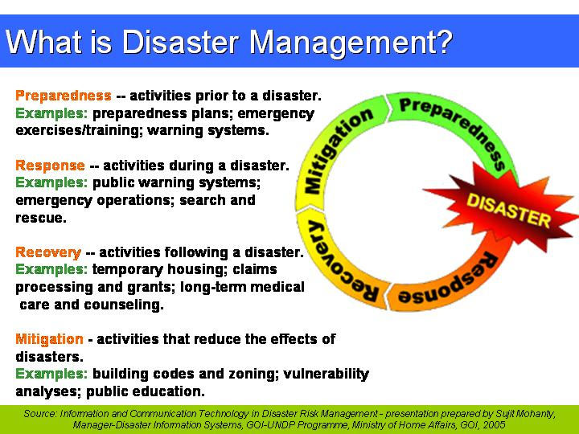
DISASTER MANAGEMENT

Slide 41
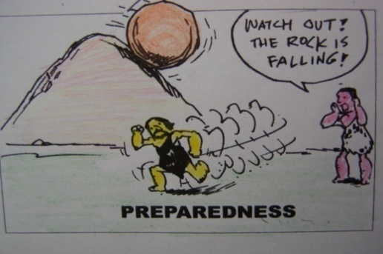
PREPAREDNESS

Slide 42

PREVENTION

Slide 43
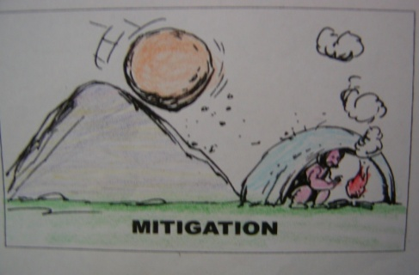
MITIGATION

Slide 44
CONCLUSION
AWARENESS
TRAINING
EQUIPMENT
RESOURCES
PLANNING
EXERCISES
PREPAREDNESS IS THE KEY TO EFFECTIVE DISASTER MANAGEMENT
Notes:
44
a. Preparedness is the key to effective event Command
(1) Preparedness is the combination of awareness, training, equipment, resources and planning.
(2) In order to be prepared for a WMD event, or any other major disaster, agencies need to establish multi-agency coordination systems.
b. Awareness
(1) First Responders need to be aware of the dangers of terrorism events and Chemical, Biological, Radiological agents.
(2) Responders need the appropriate protective equipment against Chemical, Biological, Radiological agents.
(3) Responders need training in identifying initial actions in a WMD event, including gathering and reporting information.
(4) WMD awareness helps dispel unwarranted fears.

Slide 45
NATIONAL DISASTER MANAGEMENT AUTHORITY (NDMA)
NDMA was established as per DM Act 2005
National Disaster Management Authority is an agency of MHA.
To coordinate response to natural & manmade disasters.
For capacity building in disaster resiliency & crisis response.
The PM is the ex-officio chairperson .
Agency is responsible for framing policies laying down guidelines and best practices.
Coordinating with SDMA’s to ensure holistic approach & distributed approach towards DM.

Slide 46
NDMA Guidelines
Guidelines for Nuclear attack disaster.
Guidelines on Chemical Disaster (Industrial)
Guidelines for Chemical (Terrorism Disaster )
Guidelines on Medical Preparedness and Mass Casualty Management
Guidelines for Biological Disaster
Guidelines for Psycho-Social Support
Guidelines on Formulation of State DM Plans
Guidelines for Incident Response System
Guidelines for National Disaster Management Information and Communication System
Guidelines for Scaling, Type of Equipment and Training of Fire Services

Slide 47
Role of NDMA
Lay down policies on disaster management;
Approve the National Plan;
Approve plans prepared by the Ministries or Departments of the Government of India in accordance with the National Plan;
Lay down guidelines to be followed by the State Authorities in drawing up the State Plan;
Lay down guidelines to be followed by the different Ministries or Departments of the Government of India for the Purpose of integrating the measures for prevention of disaster or the mitigation of its effects in their development plans and projects.

Slide 48
IRS STRUCTURE

Slide 49
RESPONSIBLE OFFICER
NODAL OFFICER AIR OPS
PLANNING SECTION
LOGISTICS SECTION
OPERATIONS SECTION
INCIDENT COMMANDER
Deputy I/Commander
INFORMATION OFFR
LIAISON OFFR
SAFETY OFFR
STAGING AREA
Resource Unit
Branch Rescue & Relief
Division
Geographical
Branch
Transportation
Road
Rail
Single Resource
Task Force / Strike Team
Air
Water
Service
Support
Resource Provisioning Unit
Facilities Unit
Finance
Time Unit
Compensation/
Claim Unit
Procurement Unit
Cost unit
Ground Support Unit
Situation Unit
Communication
Unit
Documentation Unit
Medical Unit
Demobilisation unit
Food Unit
Cost unit

Slide 50
IRS at State Level
Chief Secretary/ RO
NODAL OFFICER AIR OPS
HQ IRT
State EOC
INCIDENT COMMANDER
INCIDENT COMMANDER
INCIDENT COMMANDER
IRT District -A
IRT District -B
IRT District -C

Slide 51
IRS at District Level
DISTRICT MAGISTRATE/ RO
NODAL OFFICER AIR OPS
HQ IRT
DISTRICT EOC
INCIDENT COMMANDER
INCIDENT COMMANDER
INCIDENT COMMANDER
Subdivision IRT
Tehsil IRT
Block IRT

Slide 52
NATIONAL DISASTER RESPONSE FORCE
The National Disaster Response Force (NDRF) is an Indian specialized force constituted "for the purpose of special response to a threatening disaster situation or disaster" under the Disaster Management Act, 2005. Section 44-45.

Slide 53
The responsibility of managing disasters in India is that of the State Government. The ‘Nodal Ministry’ in the central government for management of natural disasters is the Ministry of Home Affairs (MHA)
National Disaster Response Force (NDRF) is under the National Disaster Management Authority. The head of the NDRF is designated as Director General. The Director Generals of NDRF are IPS officers on deputation from Indian police organizations

Slide 54
TASK & ROLL OF NDRF
Deployment in case of impending disasters.
Provide specialist response for rescue and relief in case of disaster which covers :
i) CBRN / FWR / Building Collapsed Emergencies
ii) Extrication of victims.
iii) First Medical Response to victims.
iv) Assistance to civil authorities in distribution of relief material and Restoration work. Which is define our NDRF motto Saving Lives & Beyond
(S- ops manual)

Slide 55
CONTD…
Coordination with sister agencies
Capacity building through familiarization exercise
Community awareness programs
Mock exercise
Individual training etc.
Above tasks can be assigned to NDRF Team, when deployed for OPS, for scattered and isolated incidents like drowning/accidents Team response when permission received from Commandant .
(S- ops manual)

Slide 56
COMPOSITION
National Disaster Response Force (NDRF) is a force of 16 battalions, organized on para-military lines, and manned by persons on deputation from the Para-military forces of India
Border security force -04
Central Reserve Police Force -03
Central Industrial Security force -02
Indo-Tibetan Border Police -04
Sashastra Seema Bal -02
Aasam rifles -01

Slide 57
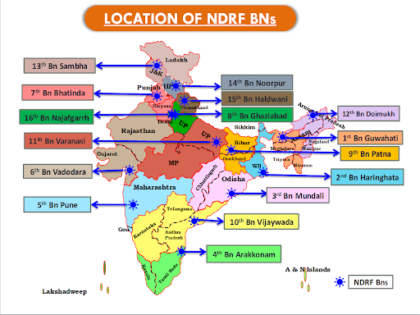

Slide 58
BN NO | UNIT | STATE | ORGANISATION
1 | Guwahati | Assam | BSF
2 | Kolkata | West Bengal | BSF
3 | Cuttack | Odisha | CISF
4 | Arakkonam | Tamil Nadu | CISF
5 | Pune | Maharashtra | CRPF
6 | Gandhinagar | Gujarat | CRPF
7 | Bhatinda | Punjab | ITBP
8 | Ghaziabad | Uttar Pradesh | ITBP
9 | Patna | Bihar | BSF
10 | Vijayawada | Andhra Pradesh | CRPF
11 | Varanasi | Uttar Pradesh | SSB
12 | Itanagar | Arunachal Pradesh | SSB
13 | Sambha | J&K & LADDAKH | ASSAM RIFLES
14 | Noorpur | Himachal pradesh | ITBP
15 | Haldwani | Uttrakhand | ITBP
16 | NAJAFGAD | DELHI NCR | BSF

Slide 59
NDRF :Functional Parameters
During
Disaster
  Specialized Response
  Proactive deployment
  Skills up-gradation
  Training other stake holders
  Creating resilient community
  Familiarization exercises and mock Drills.
Impending
Disaster
Non
Disaster
Period

Slide 60
TYPES OF DISASTER WHERE NDRF WILL RESPOND
Major Natural Disasters:-
a) Earthquakes
b) Floods
c) Cyclones
d) Landslides
e) Tsunamis
f) Avalanches
Man Made Disasters:-
a) Chemical disasters.
b) Biological disasters.
c) Radiological and Nuclear events
d) Train Accidents
e) Building Collapsed events
(iii) Any other disaster, for which the State/District authorities make a specific requisition with the exception of fire accidents

Slide 61
ROLE OF POLICE
The role essentially covers the pre disaster scene.
During the management of actual disaster situation:
  Search, Rescue, Provision of life support, mobilization and deployment of resources, communication system and maintenance of law and order.

Slide 62
ROLE OF POLICE
Ineffectiveness of various other agencies during relief and rescue work are some impediments that the police are confronted with in a disaster situation.
Crowd of spectators
Infiltration of media
Visit of VIPS and senior officers
Traffic jams
Inadequate communication
Logistics support for victims and relief operators

Slide 63
ROLE OF POLICE
MOBILIZATION OF MANPOWER
Mobilized to reach the site of disaster immediately with a view to carrying out relief and rescue operation with other agencies.
It is also the responsibility of police to maintain security and law and order to disaster location where there might be chaos and miscreants may take advantage of the situation.
Police personal deployed for such relief operations prevent occurrence of cognizable offences including all offence against property, human body and public tranquility.

Slide 64
ROLE OF POLICE
MOBILIZATION OF MANPOWER
The police regulate movement of victims, rescue and relief, medical assistance, and supplies.
A code of conduct need to be prescribed for the police personnel to be observed strictly by them in any disaster situation and the contents thereof shall be notified for general information of the public.

Slide 65
COORDINATION AMONG AGENCIES
The coordination mechanisms between NDRF, Police, Armed forces and civilian authorities need to be institutionalized.
The police has an important role in maintenance of law and order, particularly in disaster situation.

Slide 66



Slide 67

THANKS FOR YOUR
ATTENTION

Slide 68
TRAINING
After personnel and officers are deputed to the NDRF, they undergo a first responder course for SIX months.
Later on, sections of personnel get advanced specialized training in
  Deep diving,
  Special search and rescue,
  Collapsed structure search and rescue,
  Chemical Biological Radiological Nuclear emergencies, and also
  Psycho-social intervention.
Some of the personnel further undergo specialized training with national and international institutions including those on chemical and biological warfare situations

Slide 69
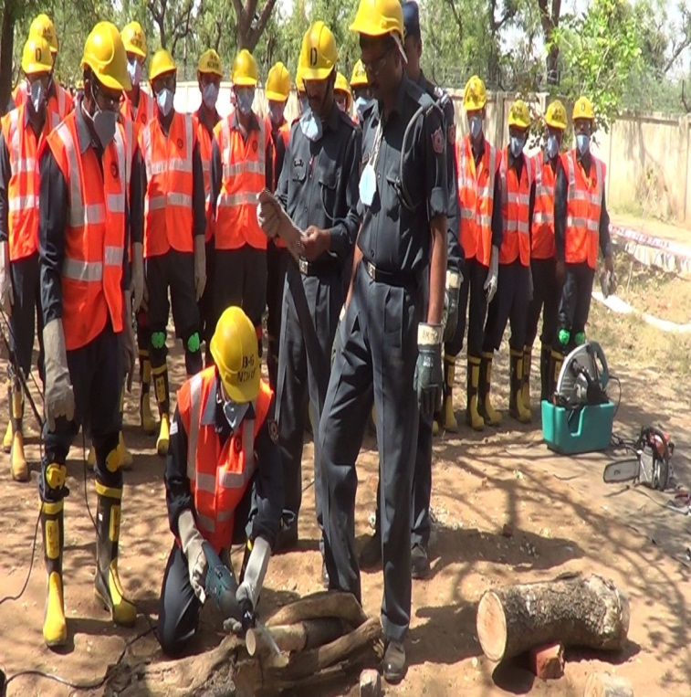
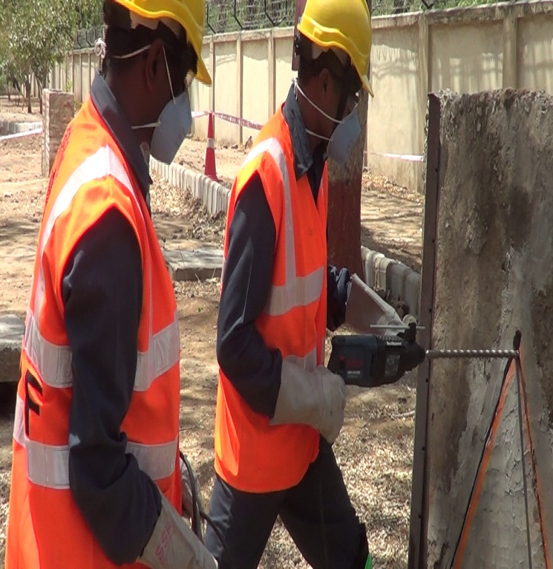
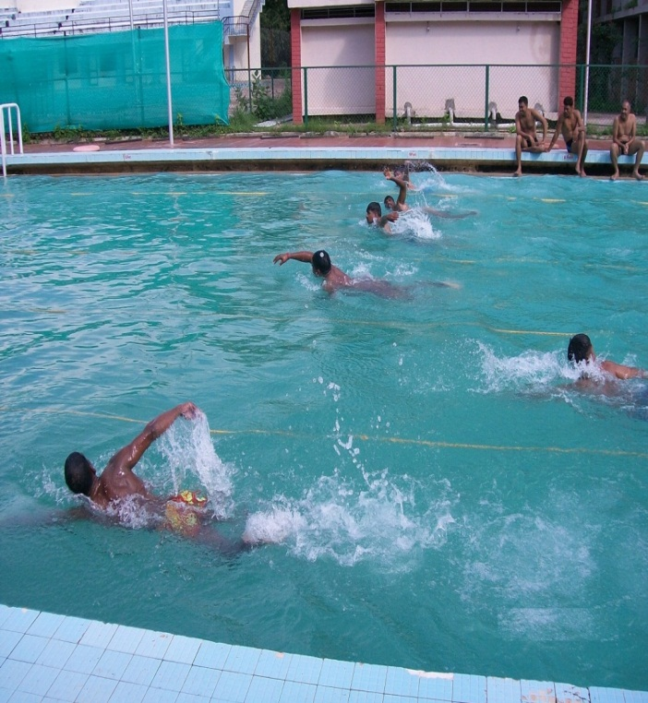
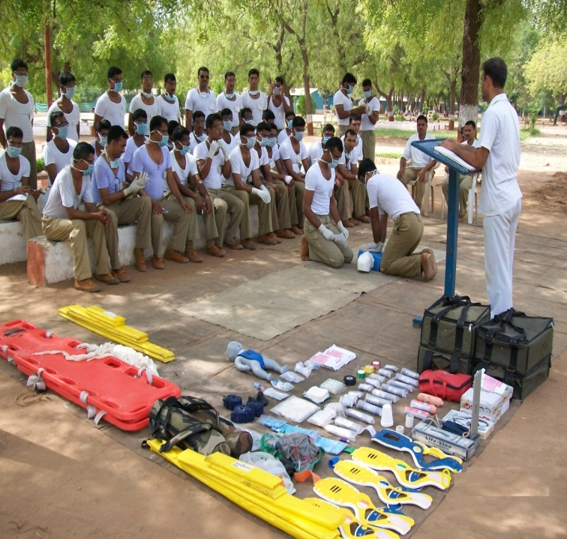
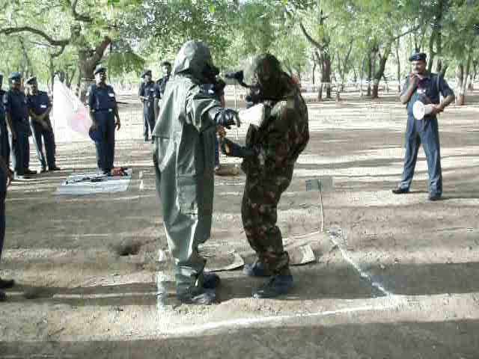
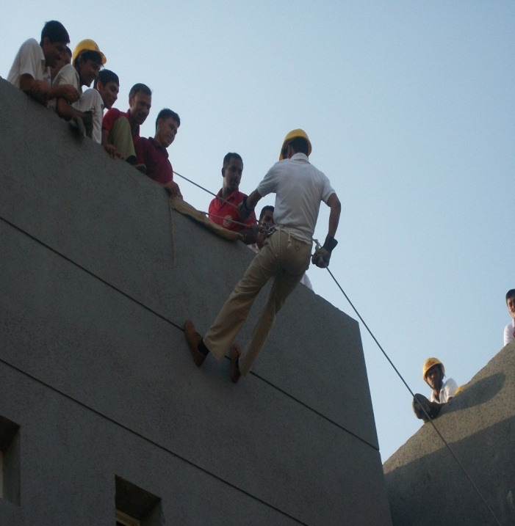
IMPARTING DM BASIC TRAINING

Slide 70
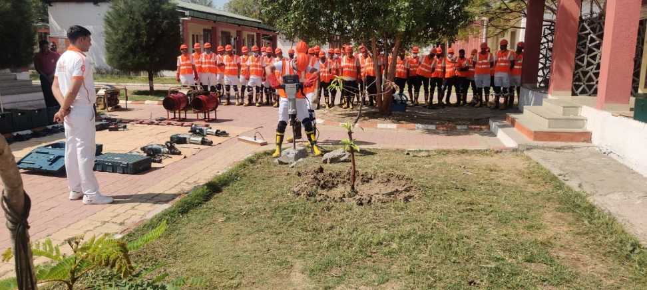
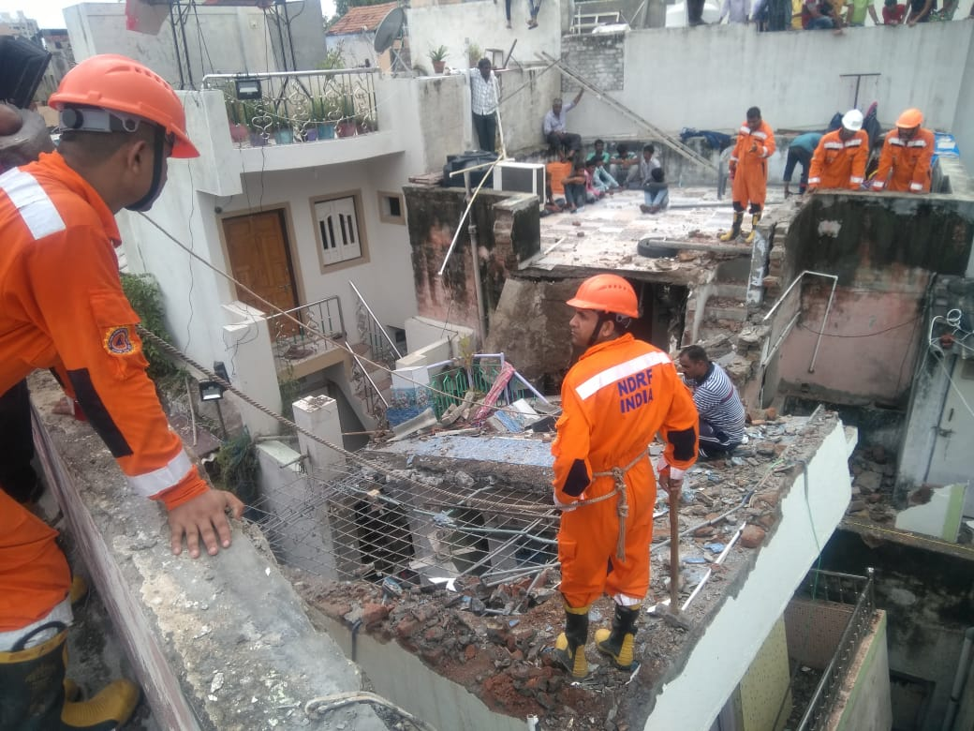
Training

Slide 71
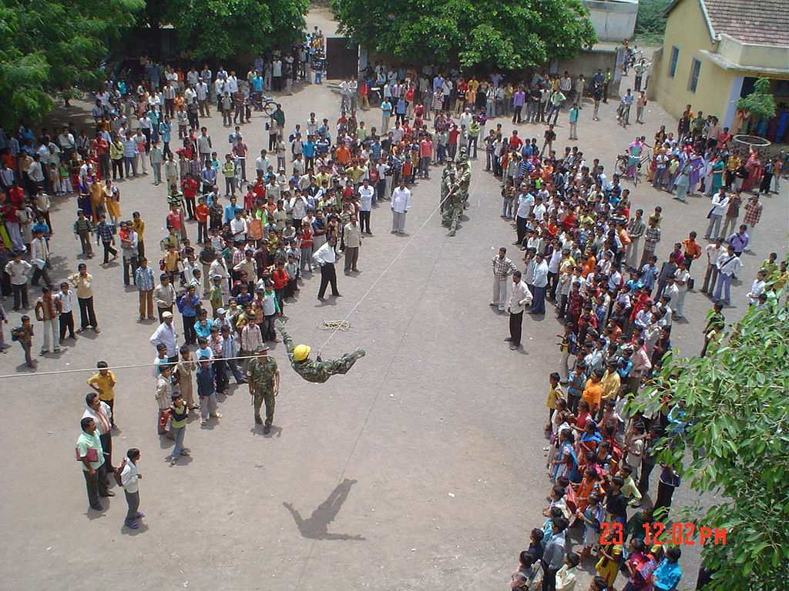
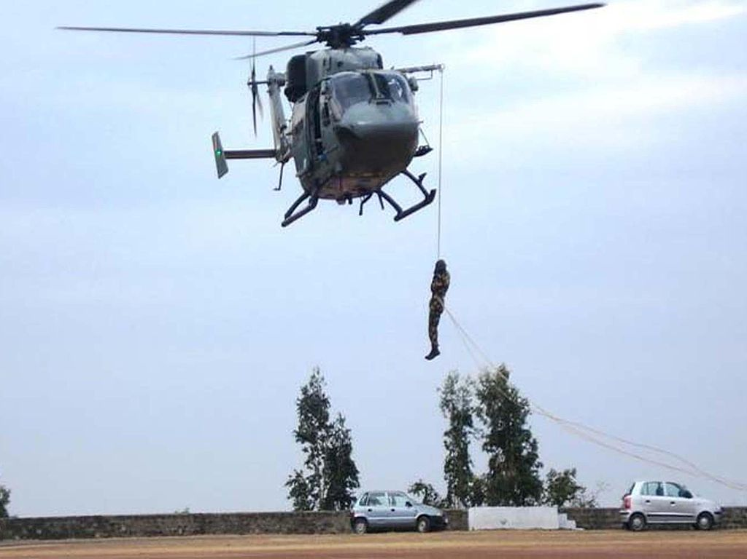
Training

Slide 72


Training

Slide 73


Training

Slide 74



Slide 75


TRAINING

Slide 76


Slide 77


Slide 78


Slide 79


Contd…

Slide 80



Slide 81



Slide 82

Contd…

Slide 83

Contd…

Slide 84

Contd..

Slide 85
Thankyou!

