Slide 1
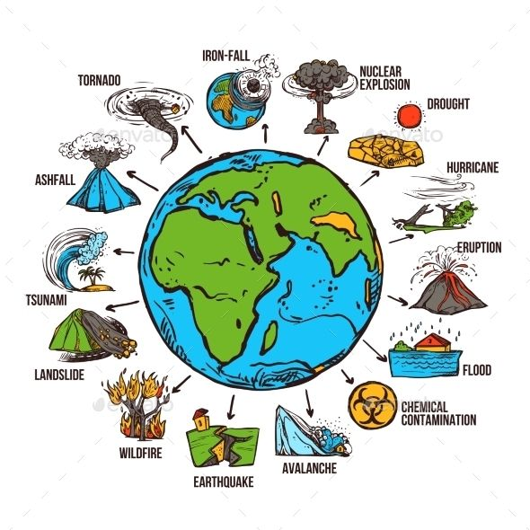
DISASTER AWARENESS’’

Slide 2
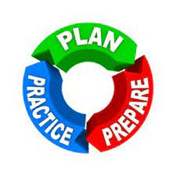
UNIVERSAL PRACTICE
DON’T PANIC DURING DISASTER.
DCH- DROP COVER HOLD (EARTHQUACK)
SDR- STOP DROP/DOWN ROLL(FIRE)
PASS- PULL, AIM, SQUEEZE,SWEEP
(F/ EXTINGUISHER)
NATIONAL EMERGENCY NUMBER-108/112(INDIA/EUROPIAN UNION)
USA-911

Slide 3
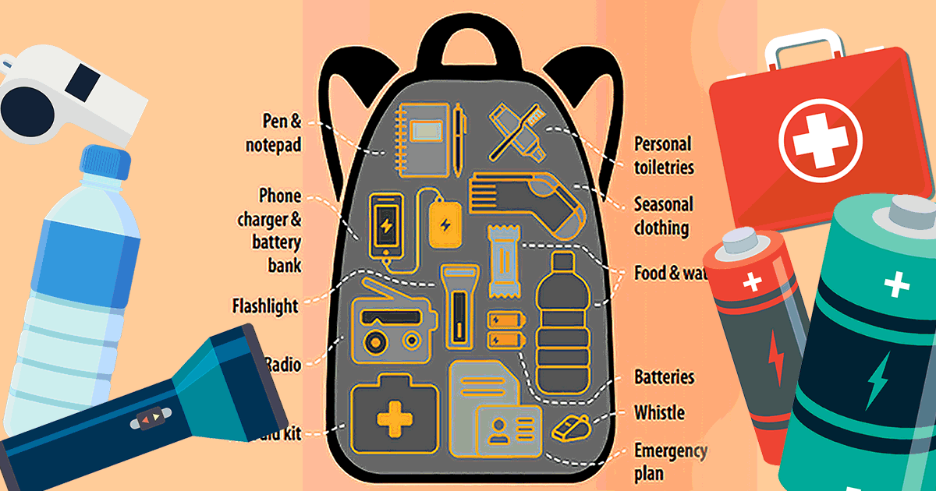
EMERGENCY DISASTER KIT

Slide 4
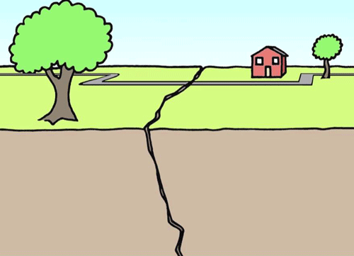
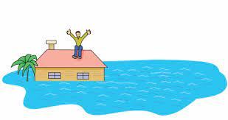
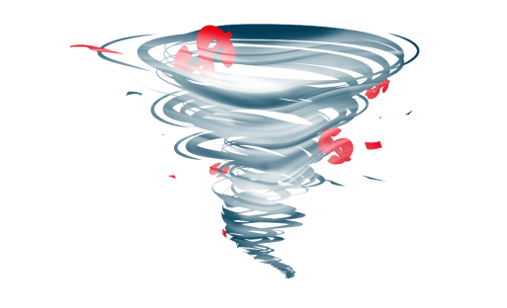
DEFINATION GLIMPSE
EARTHQUACK- SHAKING OR TREMBLING OF THE EARTH THAT IS VOLCANIC OR TECTONIC IN ORIGIN.
FLOOD- A FLOOD IS AN OVERFLOW OF WATER THAT SUBMERGES LAND.
CYCLONE- A STORM OR SYSTEM OF WINDS THAT ROTATES ABOUT A CENTER OF LOW ATMOSPHERIC PRESSURE.

Slide 5
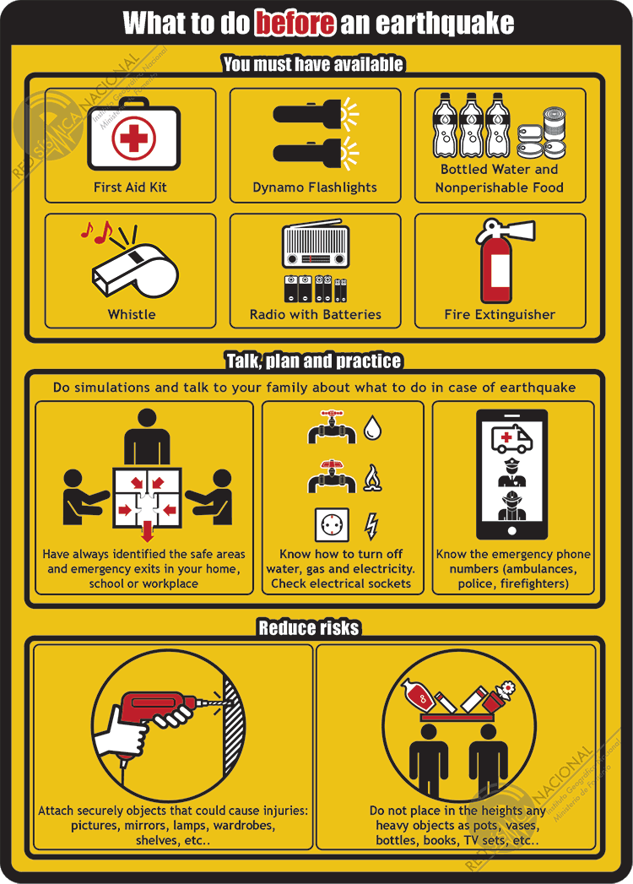
SAFETY MEASURE EARTHQUAKE

Slide 6
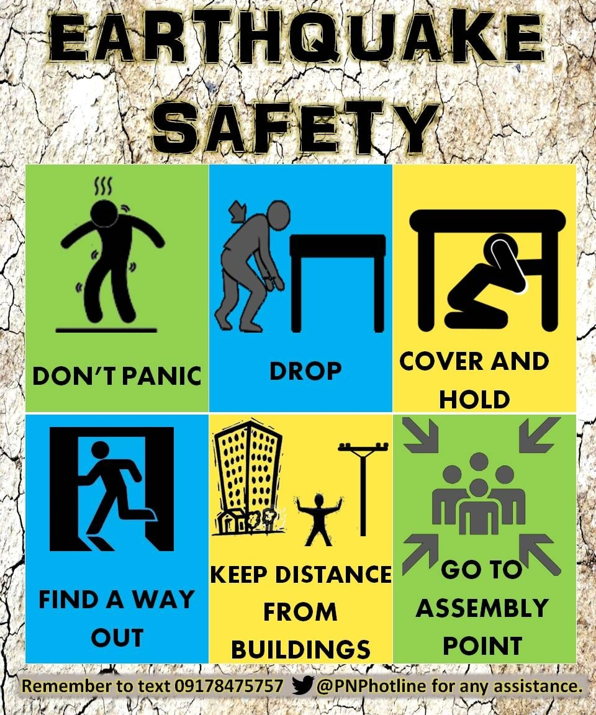
EARTHQUAKE

Slide 7
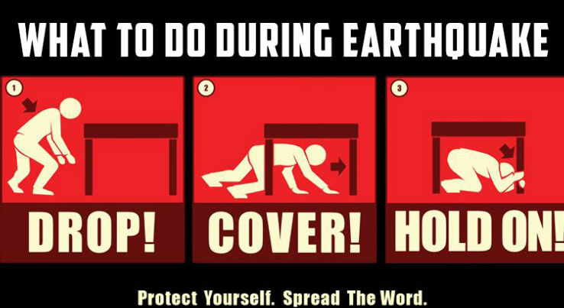
DCH

Slide 8
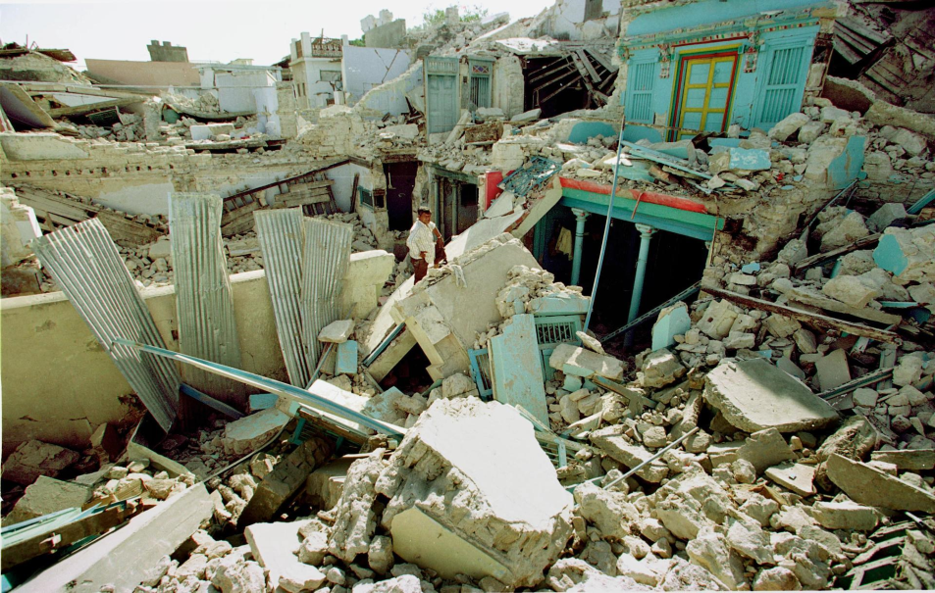
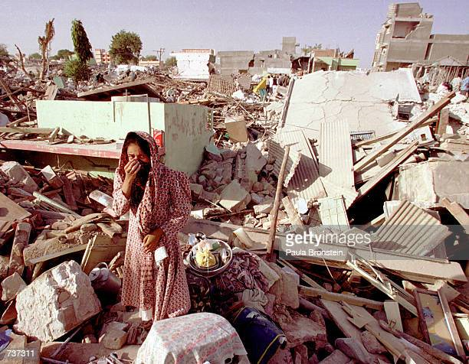
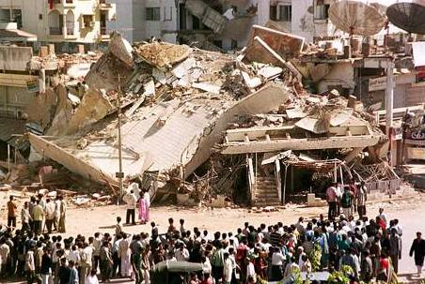
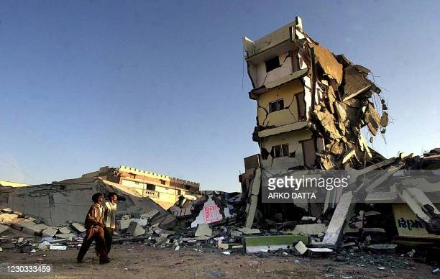
GLIMPSE BHUJ EARTHQUAKE
u6uy

Slide 9
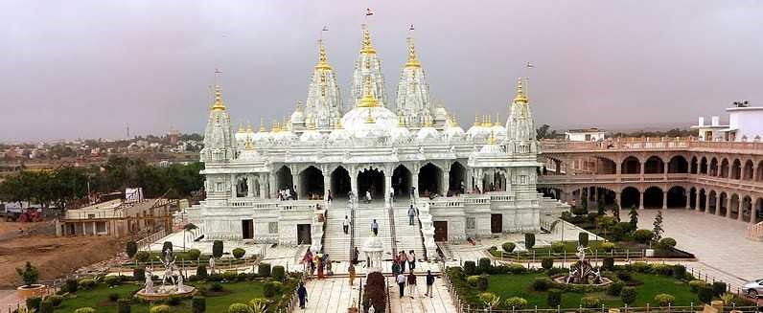
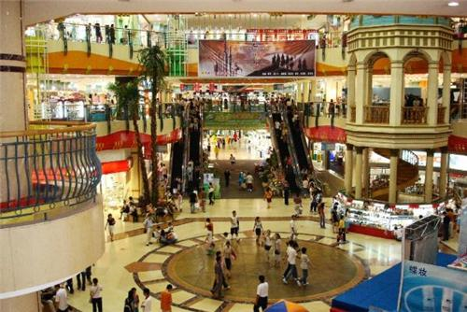
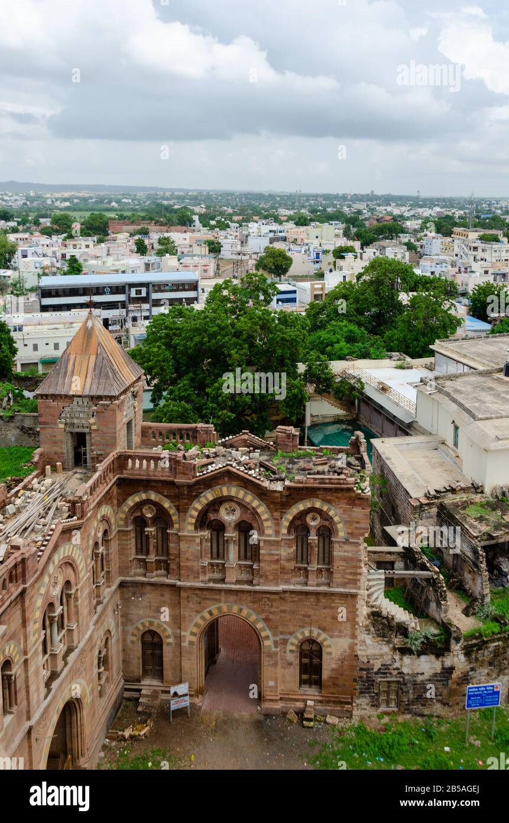
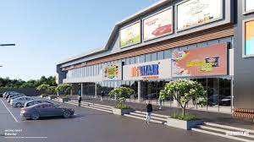
AFTER AMELIORATION/REVIVAL

Slide 10
FLOOD DO’S AND DON’T
KEEP CALM.
TUNE INTO THE NEWS.(RADIO AND TV.)
PACK A BACK UP(EMERGENCY ITEMS).
SHUT DOWN YOUR ELECTRICITY.
AVOID CONTACT WITH FLOOD WATER.
KEEP AWAY FROM ELECTRICITY POLE.
PREPARE SOME FLOATING DEVICE

Slide 11
FLOOD DO’S AND DON’T
BE AWARE OF STREAM DRAINAGE
BE AWARE OF FLASH FLOOD, IF ANY POSSIBILITY MOVE TO HIGHER PLACE
DONOT DRIVE INTO FLODDED AREA
DO NOT TOUCH ELECTRICAL EQUIPMENT.
EVACUTE IF NECESSARY.

Slide 12
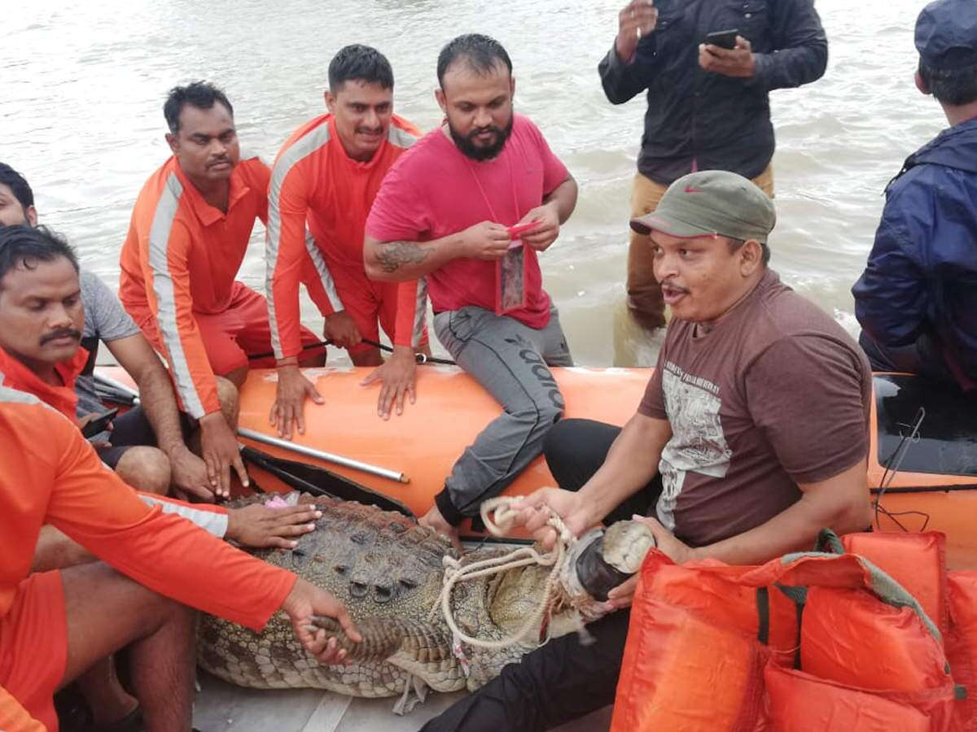
FLOOD VICTIM AT VADODARA

Slide 13
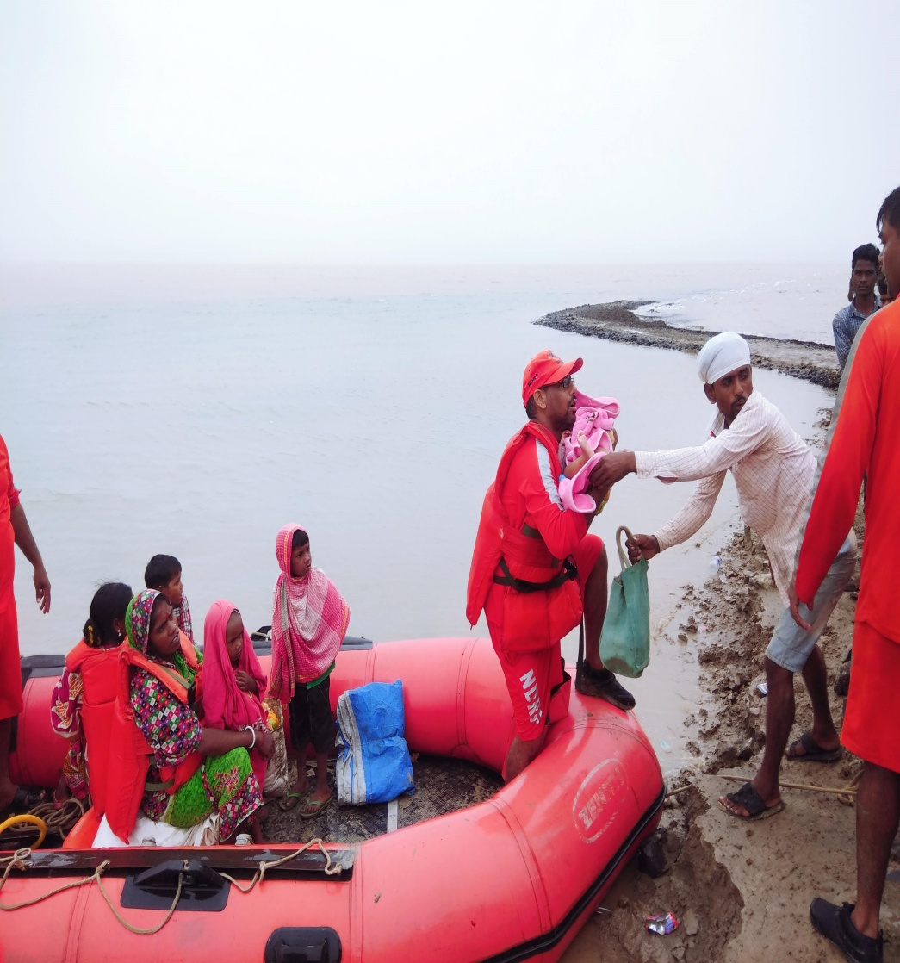
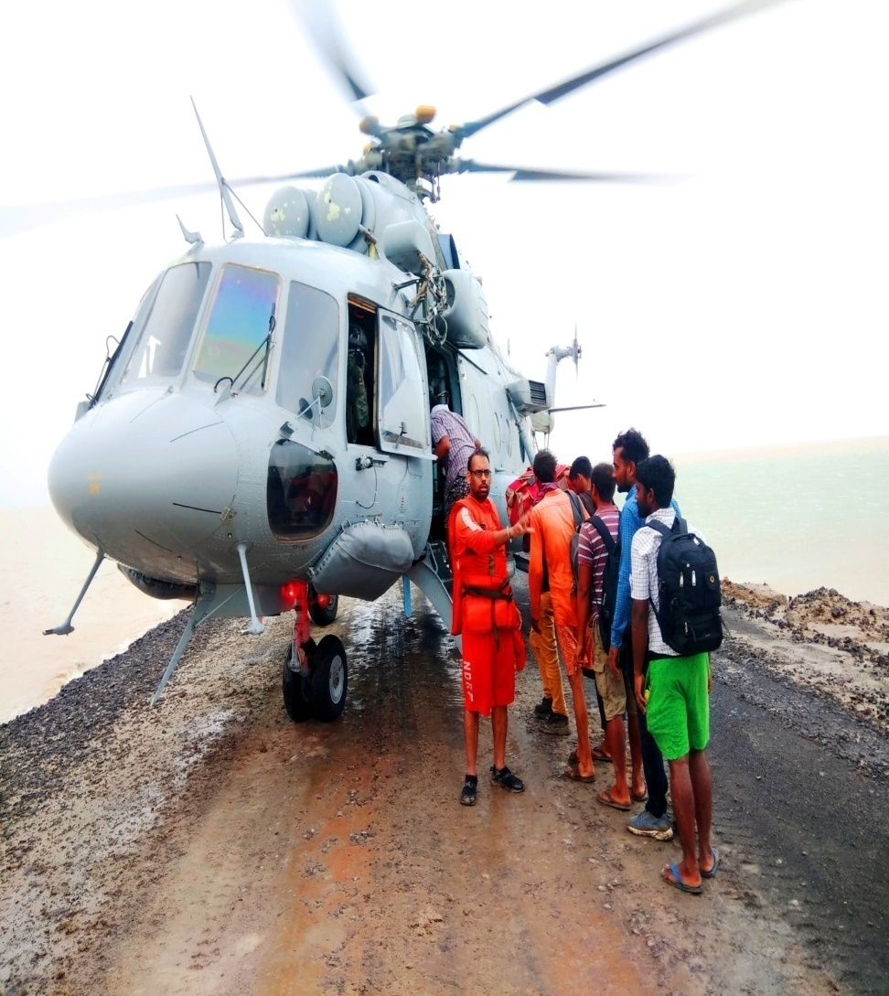
11TH AUGUST 2019, HAAJI PEER, KUTCH RESCUE OPERATION

Slide 14
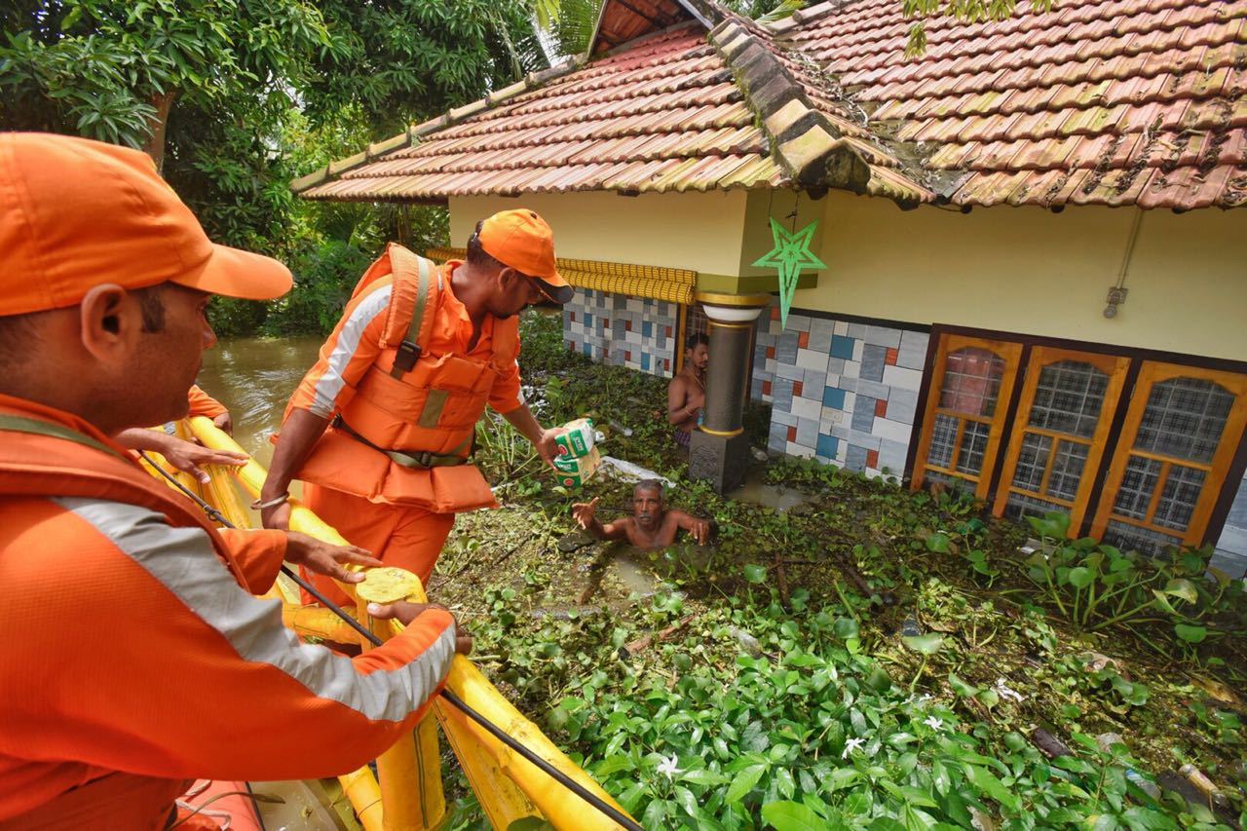
UNFORGETTABLE MOMENTS
KERALA FLOOD- AUG 2018

Slide 15
CYCLONE DO’S AND DON’T
LISTEN AND KEEP MONITORING THE WARNING
PASS THE INFORMATION TO OTHERS.
IGNORE RUMORS, THIS WILL HELP TO AVOID PANIC.
TAKE SHELTER IN THE SAFE PART OF THE HOUSE.
SWITCH OFF THE ELECTRICAL.
AVOID DRIVING AND DO NOT WORRY ABOUT YOUR PROPERTY.

Slide 16
CYCLONE DO’S AND DON’T
CHECK THE HOUSE SECURE LOOSE TILES AND CARRY OUT REPAIRS OF DOOR AND WINDOW.
REMOVE DEAD BRANCHES OR DYING TREES CLOSE TO THE HOUSE.
KEEP SOME EXTRA BATTERIES FOR TRANSISTORS.
KEEP SOME DRY NON-PERISHABLE FOOD AND WATER FOR EMERGENCY.

Slide 17
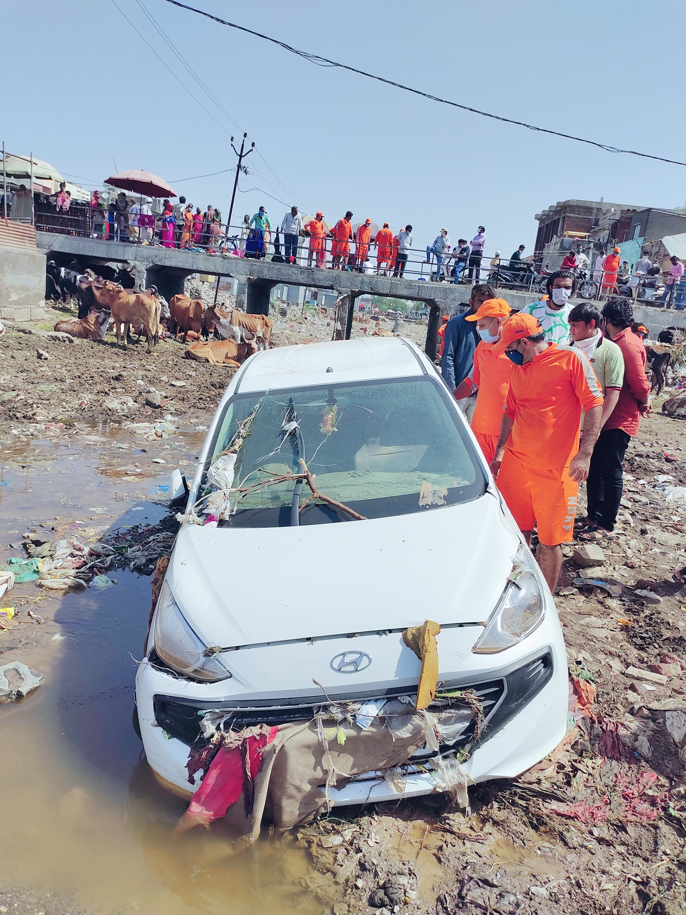
GLANCE TAUKTE CYCLONE, AMRELI-2021

Slide 18
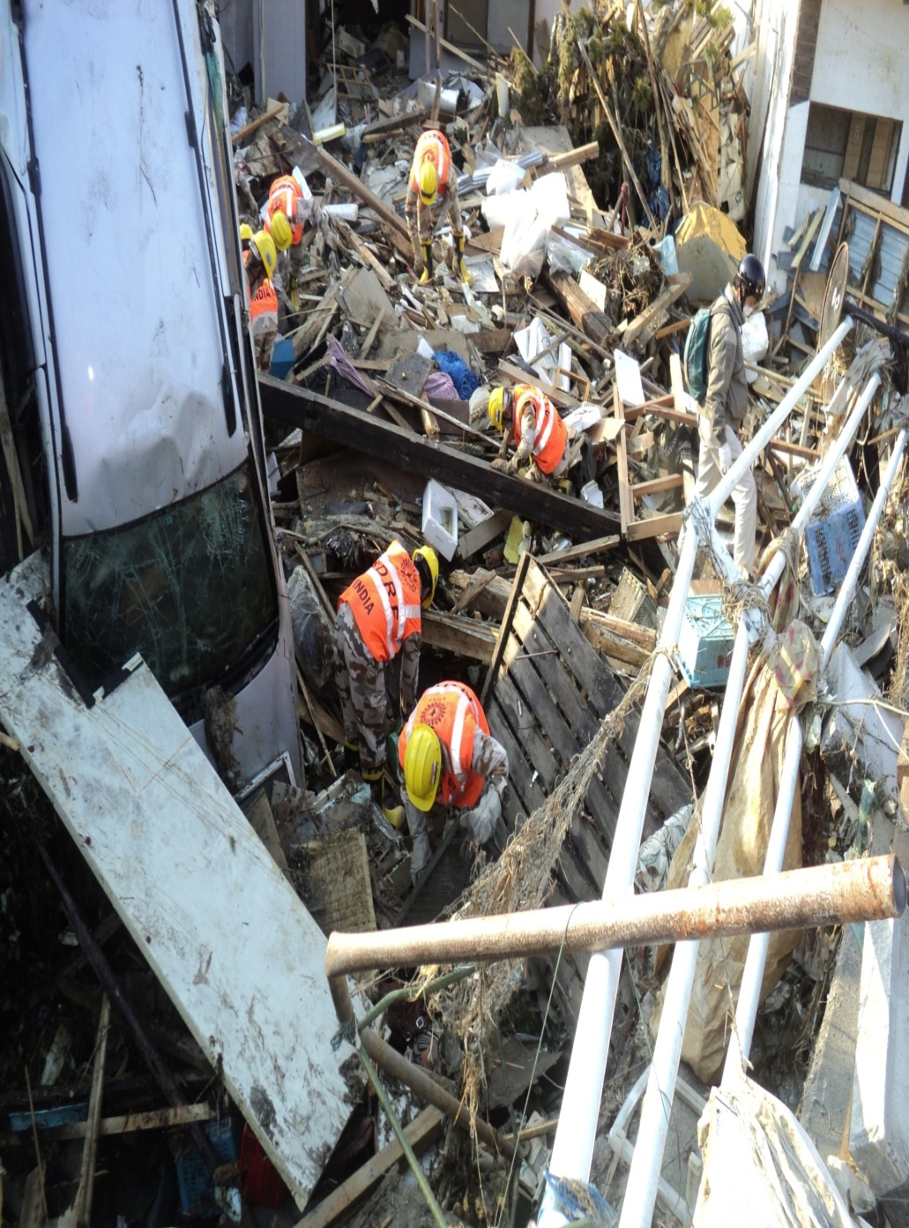
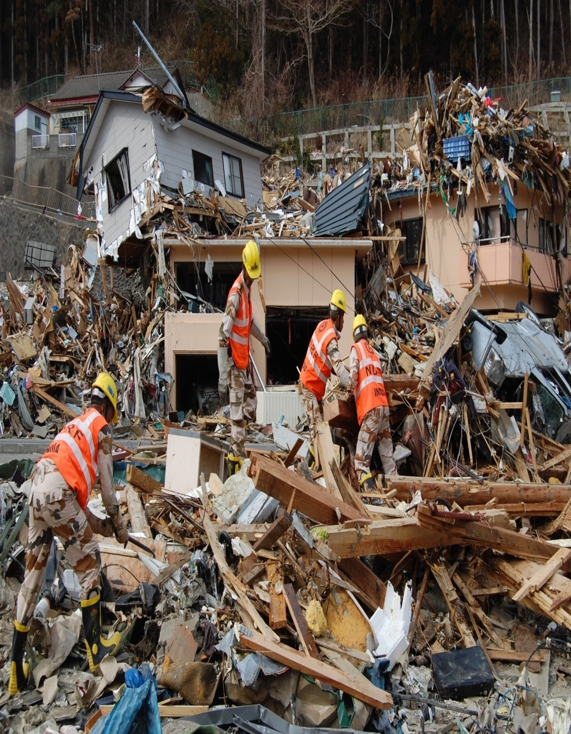
JAPAN TSUNAMI OPERATION, 2011

Slide 19
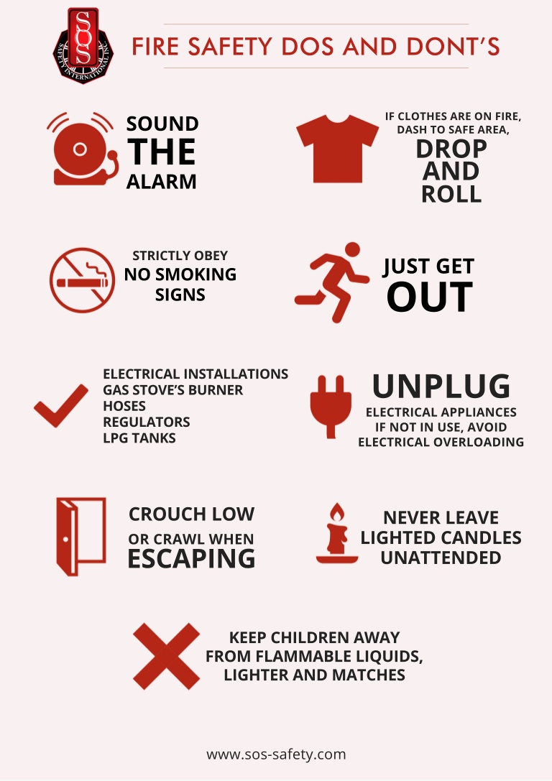
(SDR)SAFETY PRECAUTION

Slide 20
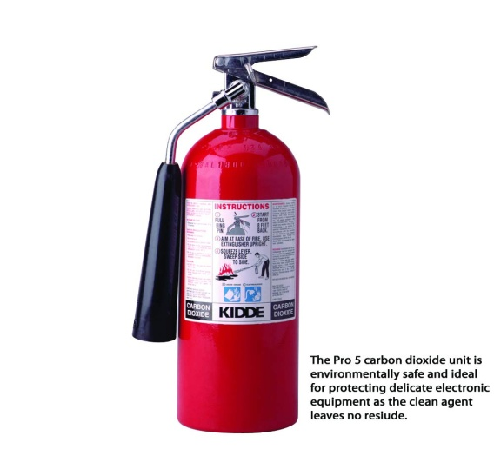
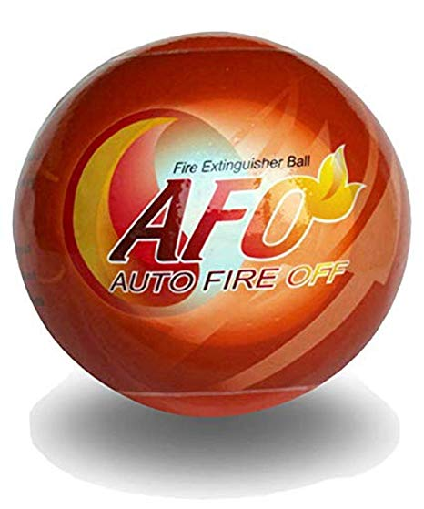

HOW TO USE FIRE EXTINGUISHER
P:-PULL THE PIN
A:-AIM THE FIRE
S:-SQUEEZE THE TRIGGER
S:-SWEEP FROM SIDE TO SIDE

Slide 21
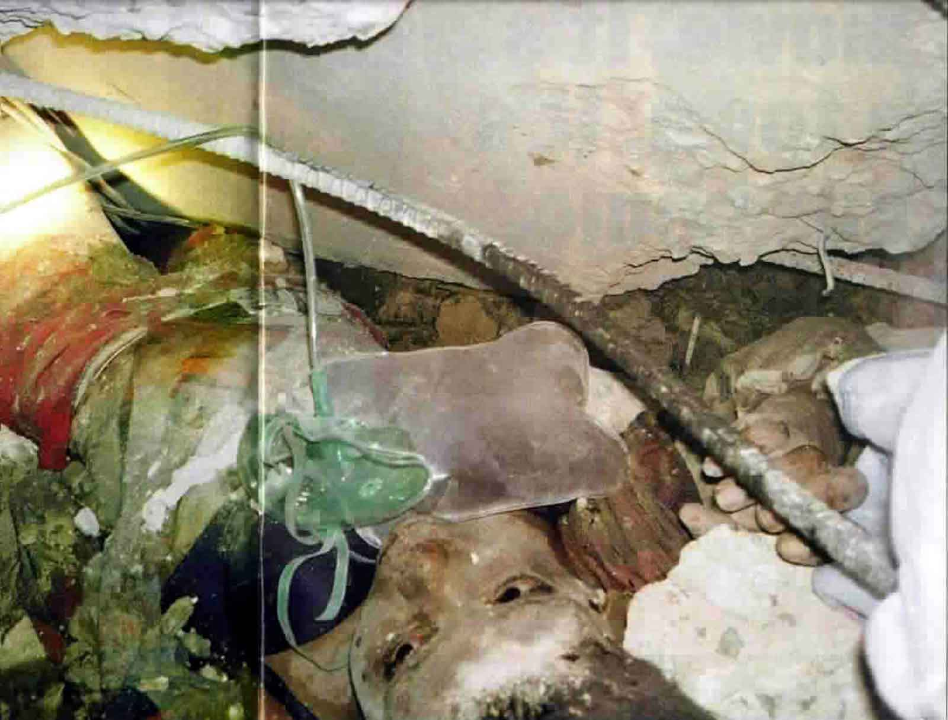
VICTIM CONTACT

Slide 22
CHEMICAL EMERGENCY
The use of chemical warfare agents in a battlefield or by terrorist (as a tool of terrorism) is associated with mass casualties, which usually proliferate beyond proportion due to an improper management of the situation. It may not be immediately recognizable and result in contamination.
Some of the major challenges in a chemical attack are the detection, contamination, disruption of transportation and other critical facilities, medical treatment of mass casualties, safety of the medical community and other responders.
11

Slide 23
After arriving at the site of incident, where chemical emergency takes place, the action of response will be :-
- Cordon off the area (100 meter dia);
- Find out the wind direction and clear the down wind side immediately .
- Rescue team comprising experts including medical doctors, nursing staff, chemists, police personnel, to put on full protective gear;
- Detect the agents using detector paper/tubes;
12

Slide 24
DONT’S
Don’t become a victim
Don’t rush in
Don’t panic
Don’t assume any thing
Don’t eat smell and touch any thing
Don’t crowed the victim
Don’t go in down wind direction
Don’t remove IPE until safe
Decontamination Team should not work more than 60 min.

Slide 25
DO’s
Canister should be changed in 30 to 60 min.
Keep the safe distance
Avoid the contact
Do emergency decon
Hazard warning to others
BIOLOGICAL & NUCLEAR EMERGENCY

Slide 26

THE MYTHS
IT CAN’T HAPPEN TO US.
THE NATURE’S FORCES ARE SO DEADLY THE VICTIMS WILL DIE ANYWAY.
THERE IS NOTHING WE CAN DO.

Slide 27

TREASURE OF LIFE

Slide 28

ANY QUESTION

Slide 29


THANKS

